Slide 1
COMP 2710 Software Construction
Use Case Analysis - Examples
Dr. Xiao Qin
Auburn University
http://www.eng.auburn.edu/~xqin
xqin@auburn.edu
Spring, 2012
1-<number>

Slide 2
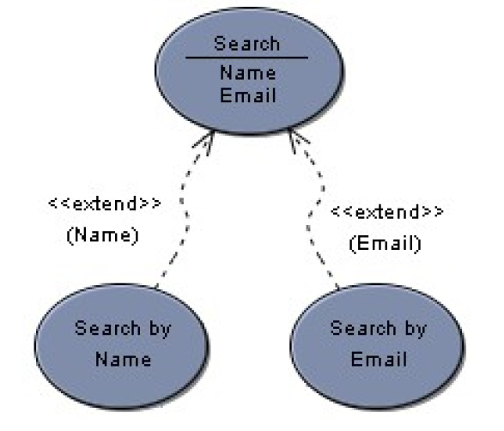
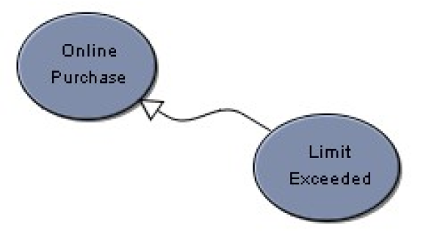
Generalization vs. Extend
A use case generalization shows that one use case is simply a special kind of another.
An extend relationship indicates that one use case is a variation of another.
Adding actions.
1-<number>
Notes:
References: Visual Case - UML Tutorial – Use Case Diagram.pdf
Generalization: (not very popular) When a use case describes a variation on another use case, use a generalization link. In the example below, the use case limit exceeded describes a situation in which the usual scenario of online purchase is not performed. Use cases that generalize another use case should only specify an alternative, even exceptional, scenario to the use case being generalized. The overall goal of the use cases should be the same. (Same Goal)
Extend: In some instances you want to describe a variation on behaviour in a more controlled form. In such instances you can define extension points in the extended use case. In the example below, search by name is said to extend search at the name extension point. The extends link is more controlled than the generalization link in that functionality can only be added at the extension points. (different Goal)

Slide 3
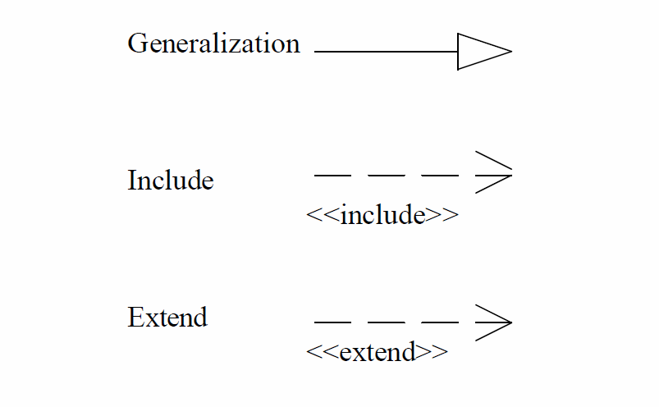
Use Case Diagrams
UML use case relationship -symbols
Relationships: Use cases may be related to other use cases.
1-<number>
Notes:
Excerices

Slide 4
Use Case Diagram - Exercise
Actors:
  customer,
  waiter,
  chef,
  cashier
Use Cases:
  order food, cook food, serve food, eat food,
  order wine, serve wine, drink wine,
  pay for food, pay for wine
Use case relationships?
1-<number>

Slide 5
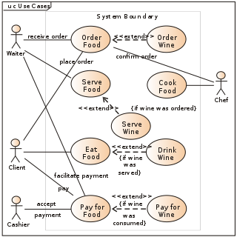
Use Case Diagram – An Example
Goto 9
1-<number>
Notes:
References: Visual Case - UML Tutorial – Use Case Diagram.pdf
Generalization: When a use case describes a variation on another use case, use a generalization link. In the example below, the use case limit exceeded describes a situation in which the usual scenario of online purchase is not performed. Use cases that generalize another use case should only specify an alternative, even exceptional, scenario to the use case being generalized. The overall goal of the use cases should be the same.
Extend: In some instances you want to describe a variation on behaviour in a more controlled form. In such instances you can define extension points in the extended use case. In the example below, search by name is said to extend search at thename extension point. The extends link is more controlled than the generalization link in that functionality can only be added at the extension points.

Slide 6
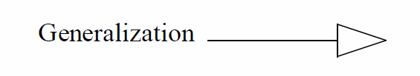
UML use case relationship symbols - Generalization
A use case that is a variation on normal behavior of another use case describes a generalization relationship.
These generalization use case relationships can be used to describe actions when an alternative behavior must be carried out for some reason.
1-<number>

Slide 7
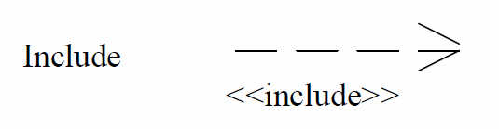
UML use case relationship include or use – Exercise
Review Transcript Data use case is used by the Register for Course use case to be sure the student has met the course's prerequisites.
Review Transcript Data use case is also used by Graduate Student use case to be sure that all program requirements have been met for graduation.
1-<number>
Notes:
reviewer ------- (review transcript data) <-- include -- (register for course)
^
|
include
|
(graduate student)

Slide 8
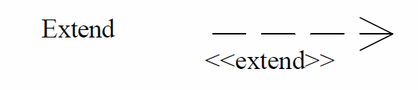
UML use case relationship symbols – extend or extends
A use case may extend a use case by adding new actions to it.
1-<number>
Notes:
<<includes>>, <<include>>, <<use>>, <<uses>>

Slide 9
UML use case relationship extend or extends – Exercise
Use case Register for Distance Course may extend use case Register for Course.
Additional actions must be performed when a student registers for a distance course.
1-<number>
Notes:
reviewer ------- (register for course) <-- extend -- (register for distance course)

Slide 10
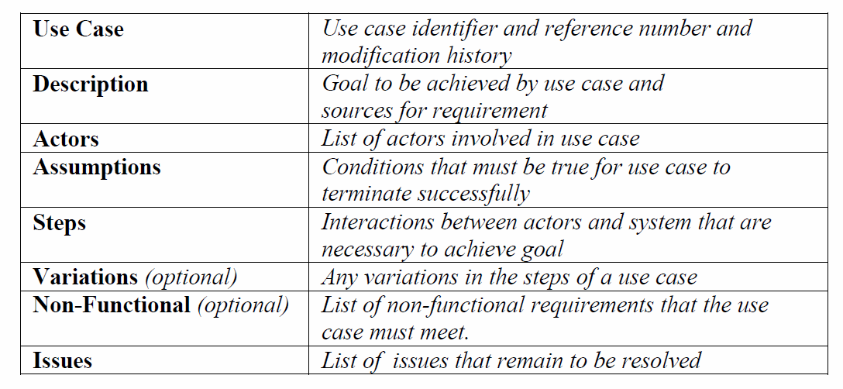
Use Case Template
Reference: http://www.bredemeyer.com/pdf_files/use_case.pdf
1-<number>
Notes:
See also: A Use Case Template.pdf

Slide 11
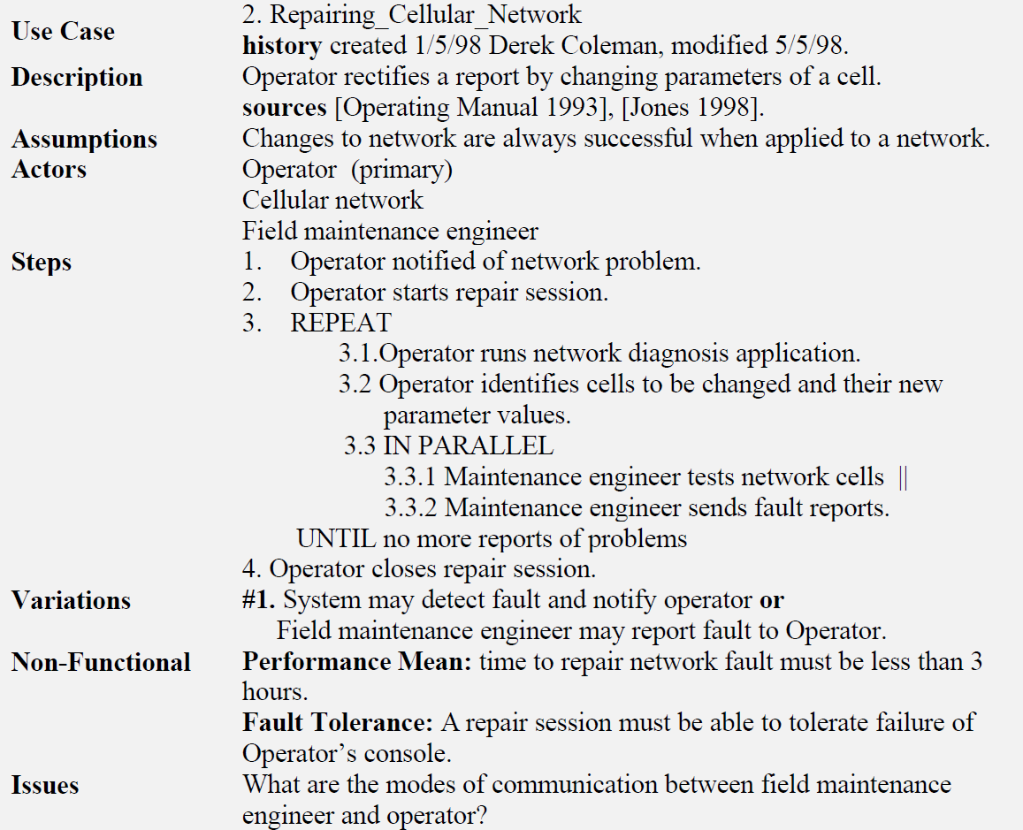
Use Case – An Example
1-<number>
Notes:
See also: A Use Case Template.pdf
The example below shows a use case that describes the interactions involved in repairing a cellular
network. The business goal of the (primary) actor the Operator is to repair the network. The other active
participants are the cellular network itself and a field maintenance engineer. The source information for the
use case comes from two sources viz. Operating Manual [1993] and [Jones 1998]. In order for the use case
to succeed it is assumed that any changes that are sent to the cellular network will not fail. That is the
network cells will change as directed.

Slide 12
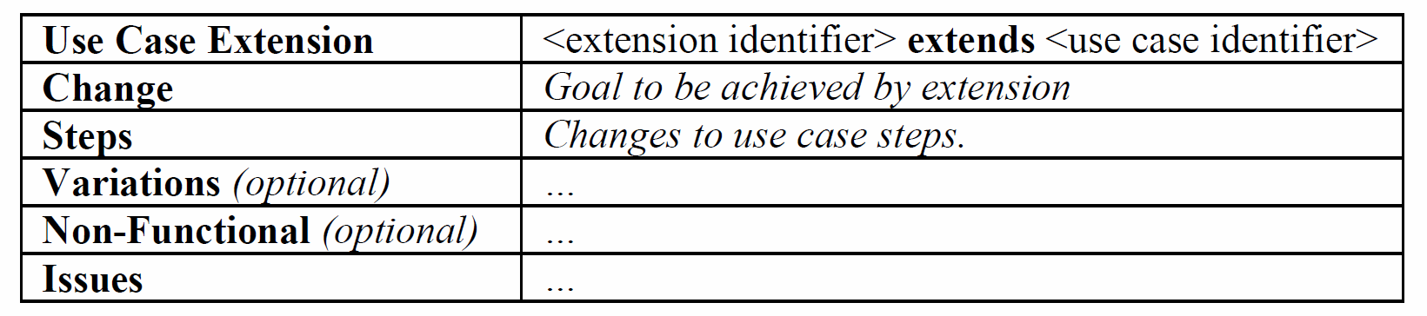
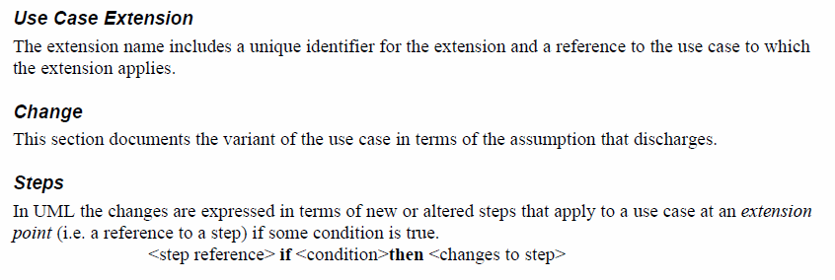
Extending a Use Case
Reference: http://www.bredemeyer.com/pdf_files/use_case.pdf
1-<number>
Notes:
See also: A Use Case Template.pdf

Slide 13
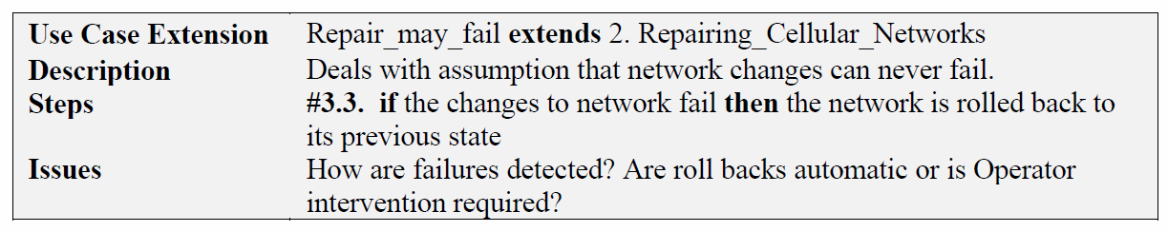
Extending a Use Case – An example
1-<number>
Notes:
See also: A Use Case Template.pdf

Slide 14

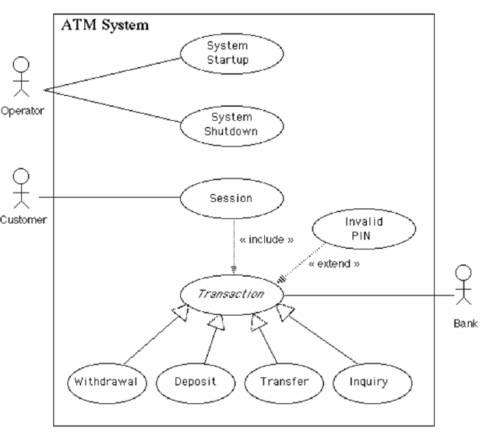
Use Case - Exercise
1-<number>

Slide 15
Summary
Use Cases describe the behavioral aspects of the system.
Use cases are not design tools.
Use Cases are a convenient way to document the functions that the system must support.
Use Cases are used to identify the components (classes) of the system.
Use case relationships?
1-<number>
Notes:
Why use cases are not design tools? - Just functional descriptions not software structure.

